Slide 1
PROBABILITY THEORY
MTM2592-Gr:2
SEVENTH WEEK
Assc. Prof. Dr. Ulku (BABUSCU) YESIL
ubabuscu@yildiz.edu.tr
ulkubabuscu@gmail.com
https://avesis.yildiz.edu.tr/ubabuscu

Slide 2
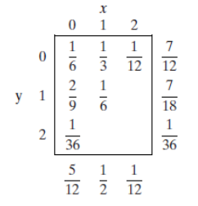
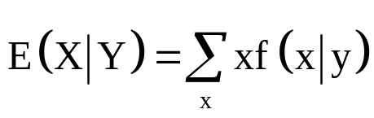
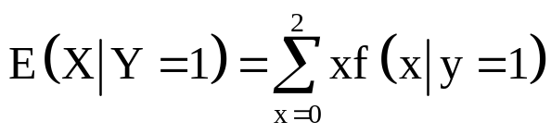
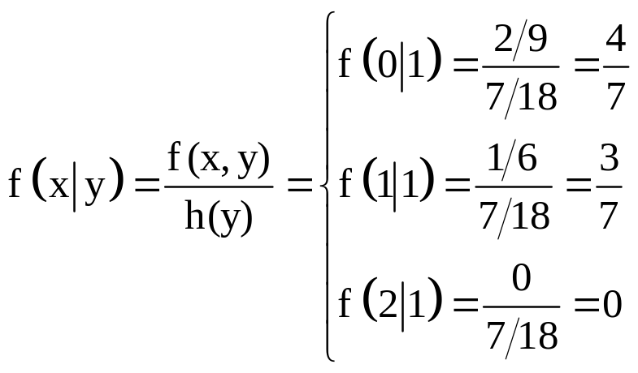
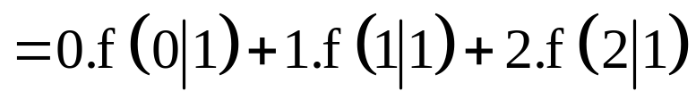
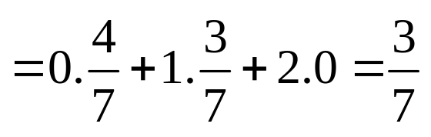
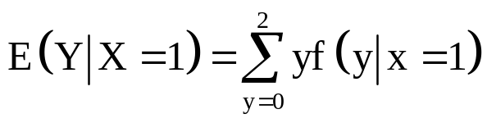
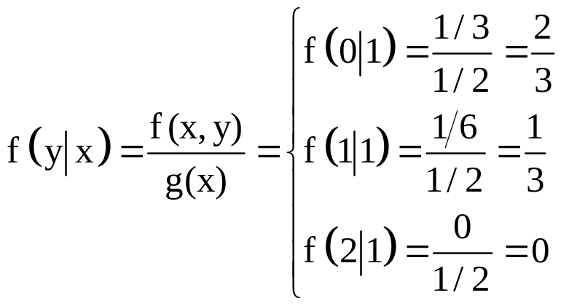
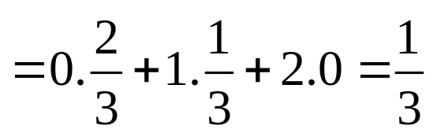
Example 1: Consider the caplets example.
Find the conditional mean of X given Y=1.
Find the conditional mean of Y given X=1.
Solution 1: a)
b)

Slide 3
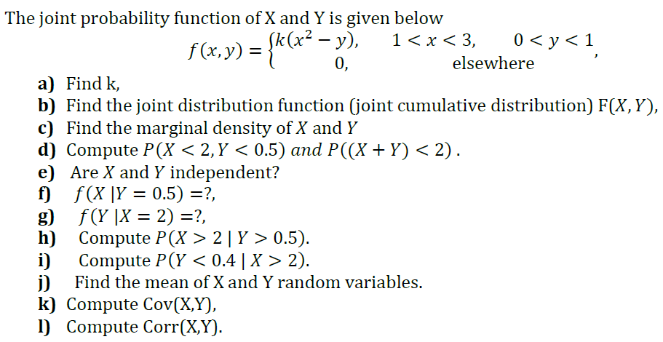
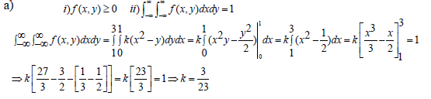
Example 2:
Solution 2:
3
1

Slide 4
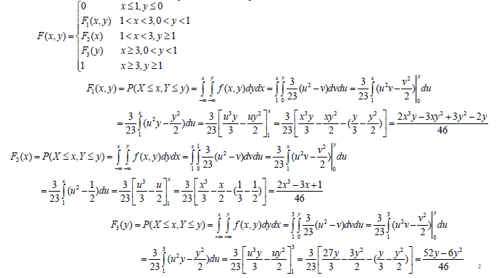

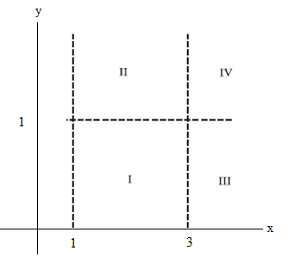
b) Joint distribution function (joint cumulative distribution )F(X,Y),

Slide 5
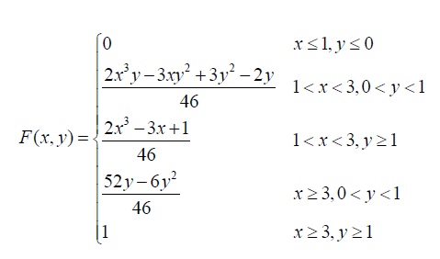

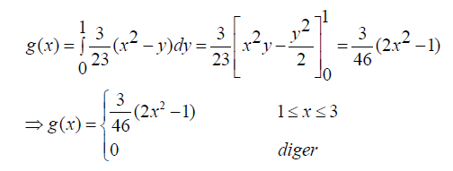
c) Marginal density of X,
elsewhere

Slide 6

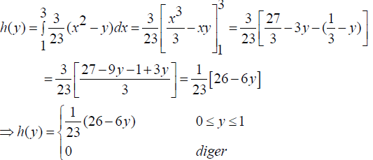

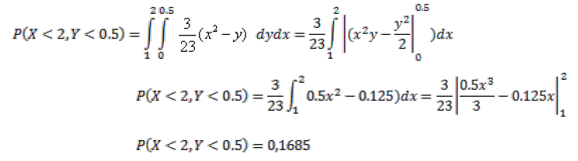
Marginal density of Y,
elsewhere
d)

Slide 7
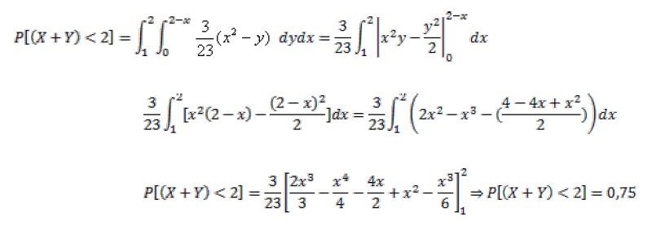


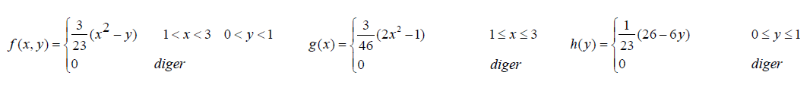

e) Are X and Y independent?
For independency
elsewhere
elsewhere
elsewhere
X and Y random variables are dependent

Slide 8
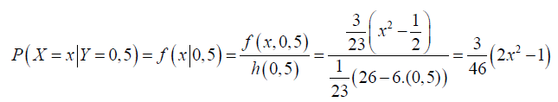
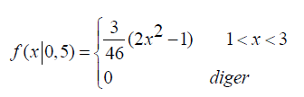
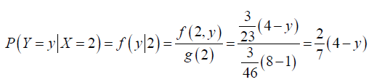
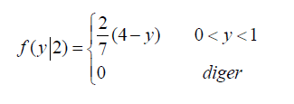
f)
elsewhere
g)
elsewhere

Slide 9

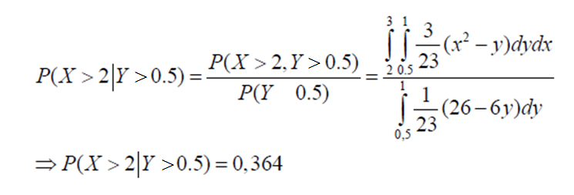

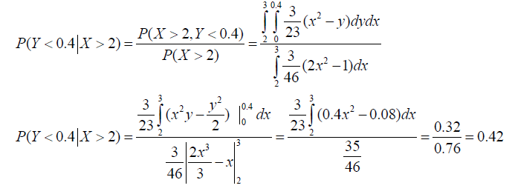
h)
>
>
i)

Slide 10
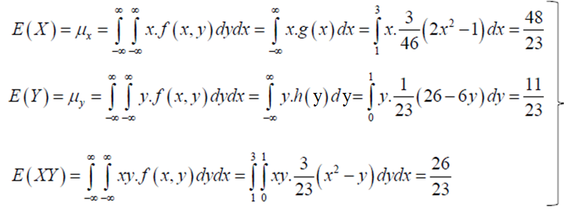


j) E(X) and E(Y)
elsewhere
elsewhere
elsewhere
X and Y random variables are dependent

Slide 11





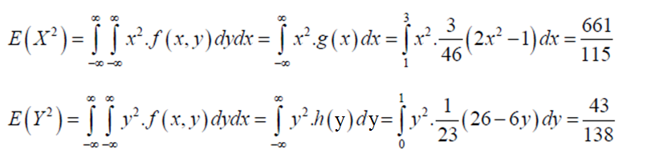
k) Cov(X,Y)
There is a positive relationship between X and Y.
l) Corr(X,Y)=
48

Slide 12
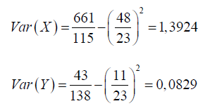

There is a weak positive relationship between X and Y.

Slide 13
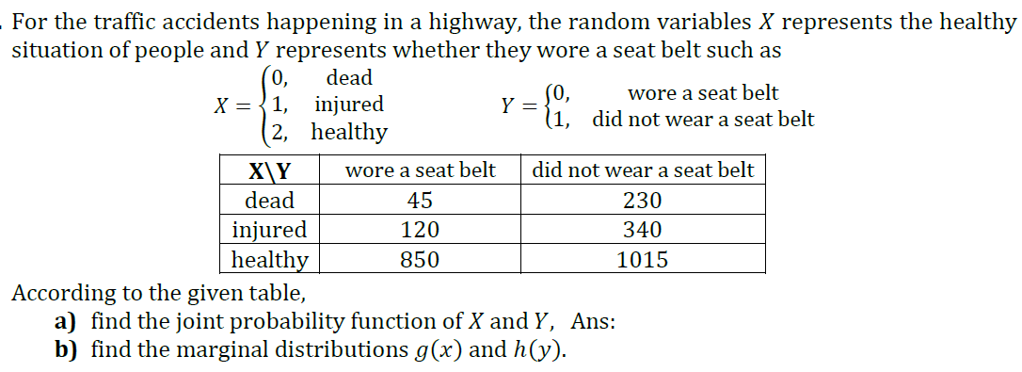
Example 3:

Slide 14
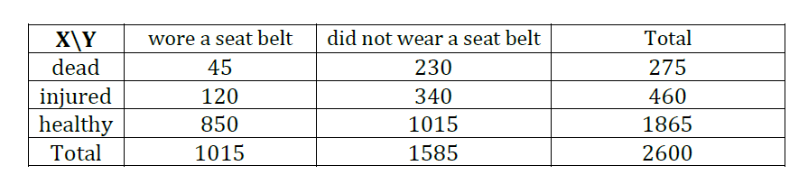
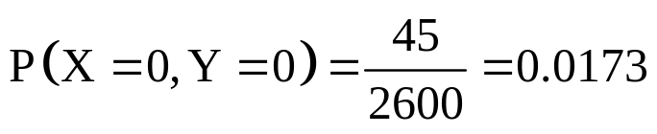
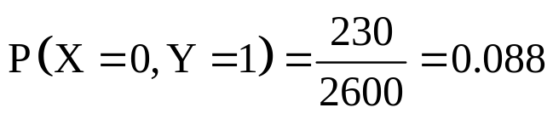
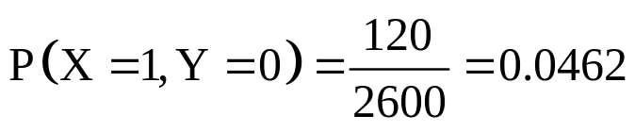
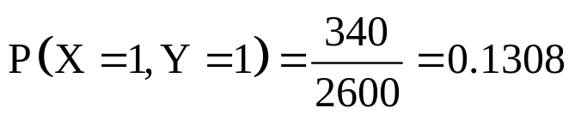
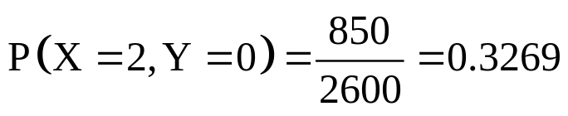
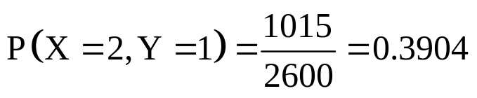
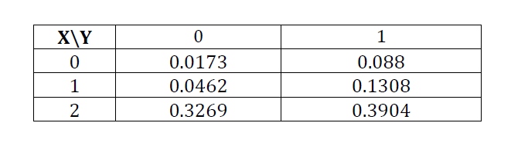


Solution 3:

Slide 15
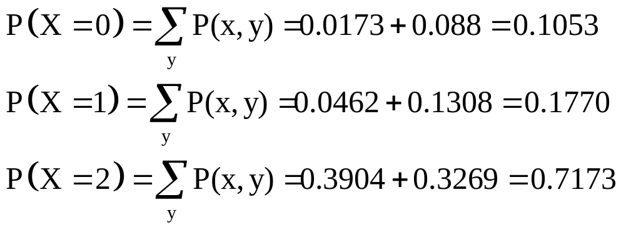


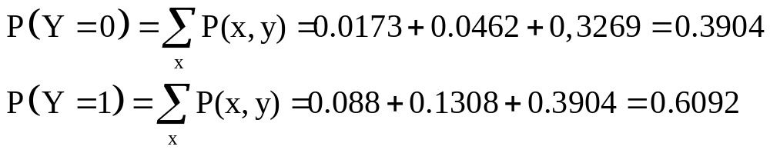


Marginal distribution of X
Marginal distribution of Y

Slide 16

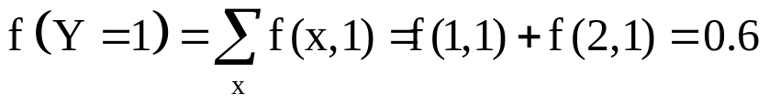
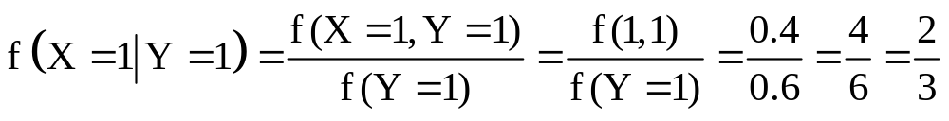
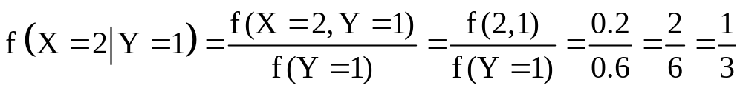
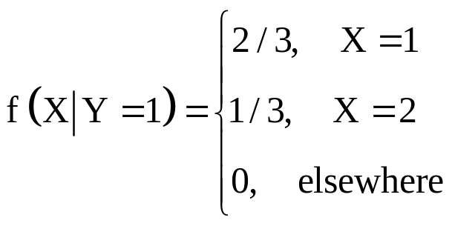
Example 4:
Solution 4:

Slide 17
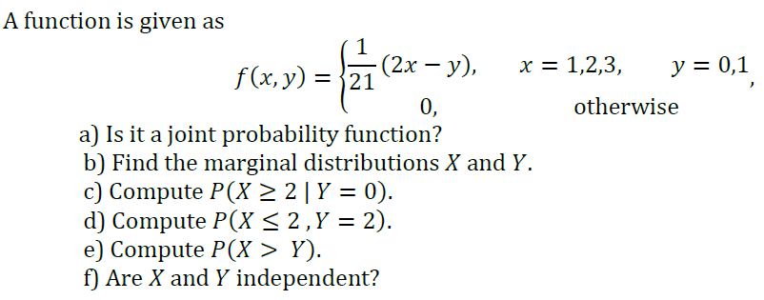
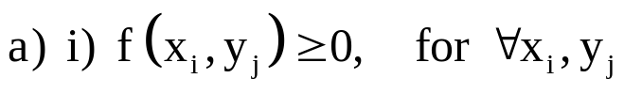
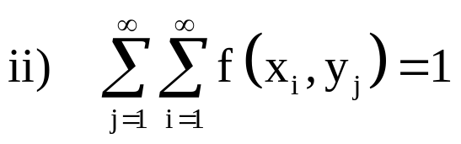
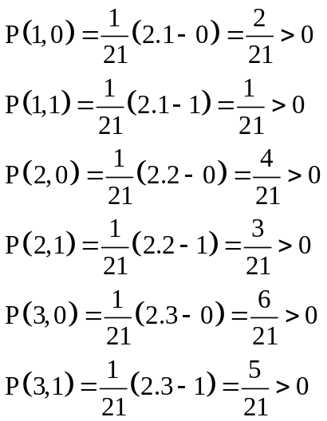
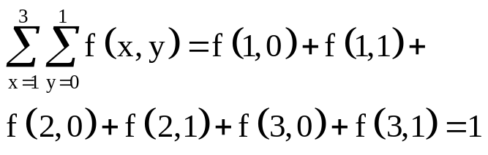
Example 5:
Solution 5:
It is a joint probability function.

Slide 18
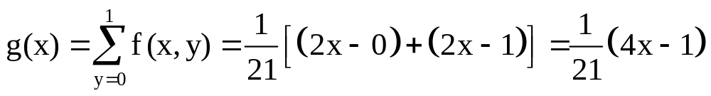
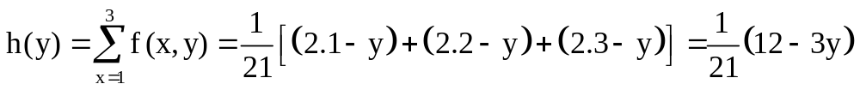




b) Marginal distribution of X
Marginal distribution of Y
?
For example; for x=1, y=0
So; X and Y are dependent.

Slide 19


Example 6:

Slide 20



Solution 6:
a) Marginal distribution of X
b) Marginal distribution of Y

Slide 21





?
For example; for x=1, y=1
So; X and Y are dependent.

Slide 22






Slide 23


Example 7:

Slide 24




Solution 7:
Other cells of the table are obtained similarly.

Slide 25




Slide 26





Example 8:
Solution 8:

Slide 27





Slide 28



WORKSHEET

Slide 29



Slide 30



Slide 31



Slide 32



Slide 33



Slide 34



Slide 35



Slide 36



Slide 37




Slide 38



Slide 39



Slide 40




